Slide 1
Cost-Benefit Analysis

Slide 2
Cost-Benefit Analysis
Cost/benefit analysis, comparing
Expected costs
Expected benefits
Issues
Estimating costs
Estimating benefits
Use of financial models to evaluate

Slide 3
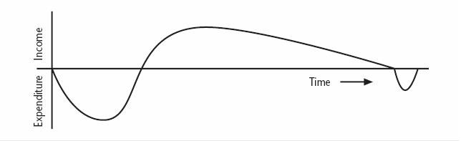
Cash Flow Forecasting
Indicates when expenditure and income will take place

Slide 4
Cash Flow Forecasting
Cash Flow Analysis
Typically there are outgoing payments initially and then incoming payments
There might be additional costs at the end of the project life
Cash flow considerations
Is initial funding for the project available?
Is timing of incoming/outgoing cash flow in line with financial plans?
If cash flow is critical, forecasting should be done quarterly or monthly
Risky/expensive projects might be funded using venture capital

Slide 5
Example of Cash Flow Forecasts
Year | Project 1 | Project 2 | Project 3 | Project 4
0 | -100,000 | -1,000,000 | -100,000 | -120,000
1 | 10,000 | 200,000 | 30,000 | 30,000
2 | 10,000 | 200,000 | 30,000 | 30,000
3 | 10,000 | 200,000 | 30,000 | 30,000
4 | 20,000 | 200,000 | 30,000 | 30,000
5 | 100,000 | 300,000 | 30,000 | 75,000
Net Profit | 50,000 | 100,000 | 50,000 | 75,000
Chapter 3-54

Slide 6
Cost-Benefit Evaluation Techniques
Costs and benefits have to be expressed using the same scale to be comparable
Usually expressed in payments at certain times (cash flow table)
Payments at different points in time are not comparable based only on the amount

Slide 7
Cost-Benefit Evaluation Techniques
Time of payment should be considered
Techniques
Net profit
Payback period
Return on investment
Net present value

Slide 8
Net Profit
Difference between total cost and total income
Pros: Easy to calculate
Cons
Does not show profit relative to size investment (e.g., consider Project 2)
Does not consider timing of payments (e.g., compare Projects 1 and 3)
Not very useful other than for quick rough evaluations

Slide 9
Payback Period
Time taken to break even (To cover the invested amount)
Pros
Easy to calculate
Gives some idea of cash flow impact
Cons: Ignores overall profitability
Not very useful by itself, but a good measure for cash flow impact

Slide 10
Return On Investment
Also known as the accounting rate of return (ARR)
Provides a way of comparing the net profitability to the investment required
The common formula
– ROI = (average annual profit/total investment) X 100

Slide 11
Return On Investment
Pros: Easy to calculate
Cons
Does not consider the timing of payments
Misleading: does not consider bank interest rates
Not very useful other than for "back of envelope" evaluations

Slide 12
Net Present Value
A project evaluation technique that takes into account the profitability of a project and the timing of the cash flows that are produced
Sum of all incoming and outgoing payments, discounted using an interest rate, to a fixed point in time (the present)

Slide 13
Net Present Value
Present value = (value in year t)/(1+r)^t
r is the discount rate
t is the number of years into the future that the cash flow occurs

Slide 14
Net Present Value
(1+r)^t is known as discount factor
In the case of 10% rate and one year
– Discount factor = 1/(1+0.10) = 0.9091
In the case of 10% rate and two years
– Discount factor = 1/(1.10 x 1.10) = 0.8294

Slide 15
Net Present Value
Discount Factor (10%)
Discounted Cash Flow
Year
Cash Flow
0 | -100,000 | 1 | -100,000
1 | 10,000 | 0.9091 | 9,091
2 | 10,000 | 0.8264 | 8,264
3 | 10,000 | 0.7513 | 7,513
4 | 20,000 | 0.683 | 13,660
5 | 100,000 | 0.6209 | 62,090
 |  | NPV | 618
 |  |  | Chapter 3-64

Slide 16
Net Present Value
Pros
Takes into account profitability
Considers timing of payments
Considers economic situation through discount rate
Cons: Discount rate can be difficult to choose
Standard measure to compare different options

Slide 17
Example 1
A company projecting revenue of 40 lacs in first year and the revenue is going to increase @10 lacs every year for the next 3 years in succession, after which revenue decreases by 15 lacs in the fifth year and thus will be closed after 5 years.
The fixed initial investment for the project is 150 lacs and working capital requirement is 30 lacs.
Compute these for the project :
Payback Period
ROI
NPV assuming 12.5% discount rate

Slide 18
SOLUTION
Payback period
= time taken to pay back the total investment of 180 Lac
= 3 + (30/70) years = 3.43 years
Average Annual Profit = Net Profit ÷ Project duration
= 95 lacs ÷ 5 = 19 lacs.
Hence, the ROI = (average annual profit / total investment ) * 100
= (19/180) * 100 = 10.55 %
Calculation of NPV :
Year | Cash flow | Discount factor @12.5% | Discounted cash flow
0 | -180 L | 1.0000 | -180 L
1 | 40 L | 0.8889 | 35.556 L
2 | 50 L | 0.7901 | 39.505 L
3 | 60 L | 0.7023 | 42.138 L
4 | 70 L | 0.6243 | 43.701 L
5 | 55 L | 0.5549 | 30.5195 L
Net Profit : | RS 95 Lacs | NPV : | Rs 11.4195 L

Slide 19
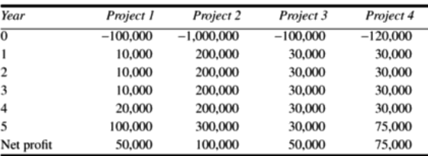
Example 2

